Slide 1
IMDB MOVIE ANALYSIS DATA ANALYTICS
Project report
Submitted by:
Shadiya

Slide 2
Project description
A Dataset having various columns of different IMDB Movies is provided. We are required to provide a detailed report for the below data record mentioning the answers for the questions.
A. Cleaning the data: Removing the null/blank cells, unnecessary rows and columns, also duplicate rows.
B. Find movies with highest profit: Find profit by gross-budget. Then display most profit movies in the list.
C. Top 250: Find top 250 movies with IMDB Rating with respect to the imdb_score given in the dataset. Also we have to find out top foreign language films other than English.
D. Top Directors: Find top 10 directors whose mean of imdb_score is the highest.
E. Popular Genres: Find the popular genre of movies using count of movie titles.
F. Critic and audience favourite actors:
i) First task is to create three columns for three actors and extracting movies in which they played lead role and combine them.
Ii) Find the critic favourite and audience favourite actors with respect to the highest mean of num_critic and num_user reviews.
Iii) Prepare chart for sum of voted users vs decade.

Slide 3
Approach
Downloaded and imported given dataset (csv file) to Excel sheet.
Cleaned the data and kept only the required information.
Created pivot tables. Used different excel tools, filter and sort functions, excel formulas etc. Created necessary charts and plots etc. to get the correct answers to the questions asked.
While doing the project, prepared ppt and explained each task step by step and displayed charts and screenshots from excel sheets as required.
Hyperlinked the working sheet into the ppt for clarification.
Attached loom video explaining how I did the project.

Slide 4
Tech stack used
Microsoft Excel 2016 for doing the analysis.
Microsoft Powerpoint 2016 for project report.
Loom as screen recorder.

Slide 5
A. CLEANING THE DATA - Insights
Understand the whole project and read through questions to find out unwanted columns given in the dataset.
1. Delete unnecessary columns:
(colour, duration, director_facebook_likes, actor_3_facebook_likes, actor_2_name, actor_1_facebook_likes, cast_total_facebook_likes, actor_3_name, facenumber_in_poster, plot_keywords, movie_imdb_link, content_rating, actor_2_facebook_likes, aspect_ratio, movie_facebook_likes)
2. Removing duplicate rows:
Ctrl+A (select all cells in the table)
Data –> Remove Duplicates ( 47 Duplicate values were found and removed, 4996 remained)
3. Finding null/blank cells and removing those rows
Ctr+A
Home -> Find & Select -> Go to Special -> Blanks -> OK (Blank cells are then Highlighted)
With that selection, Go to Home -> Delete -> Delete Sheet Rows
After cleaning total 3850 rows and 13 columns were only present. The worksheet was saved as Cleaned_Data.

Slide 6
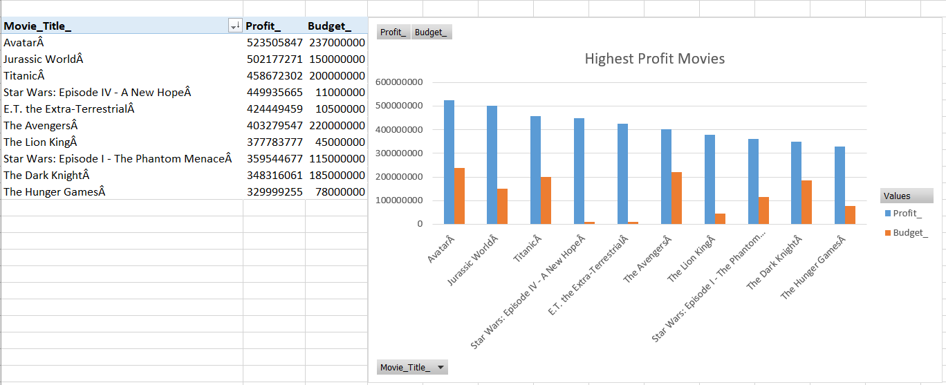
B. Movies with the Highest Profit
Inserted “Profit” column and assigned values (Profit =Gross_col – Budget_col)
Sorted the “Profit” column from largest to smallest values. Selected first 10 rows.
Created pivot table to a different worksheet “Highest_Profit” with columns movie_title, profit and budget.
Plotted graph with profit on y-axis and budget on x-axis.
The Highest Profit Movies are:
Avatar (₹ 52,35,05,847.00)
Jurassic World (₹ 50,21,77,271.00)
Titanic (₹ 45,86,72,302.00)
Star Wars (₹ 44,99,35,665.00 )

Slide 7
C. Top 250
First sorted imdb_score column from largest to smallest.
Converted num_voted_users to numbers format (Data->Text to Columns).
Filtered num_voted_users greater than 25000 and selected top 250 movie_titles.
Copied them to another worksheet with movie_titles, num_voted_users, imdb_score and language column. Named worksheet as Top_250.
Ranked movies according to imdb_score using formula: =SUMPRODUCT((D2<=$D$2:$D$251)/COUNTIF($D$2:$D$251,$D$2:$D$251))
Filtered language without English movies and found top ten foreign languages. Displayed them in new column Top_Foreign_Lang_Film.

Slide 8
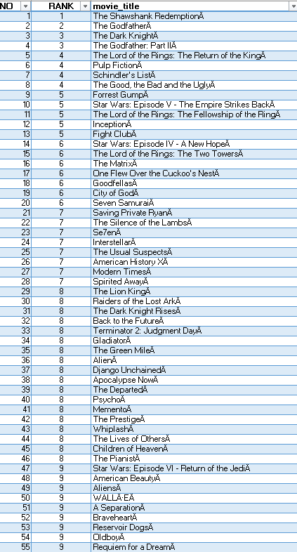
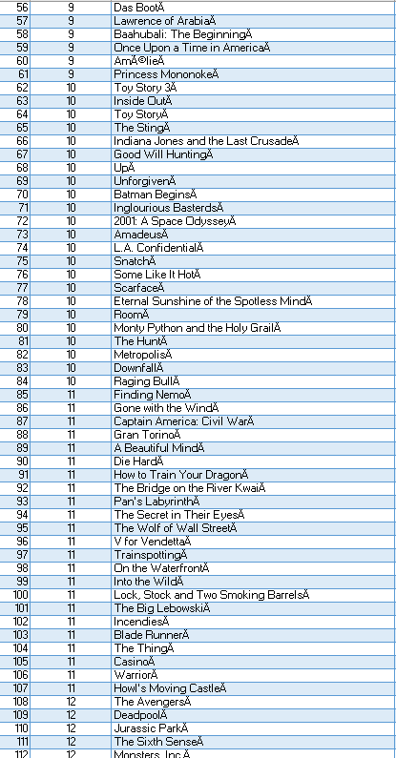
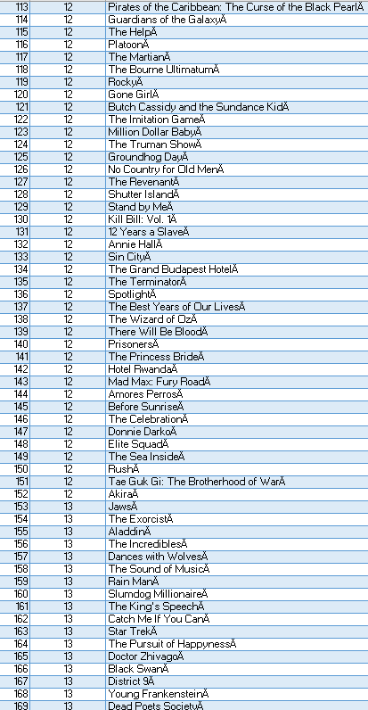
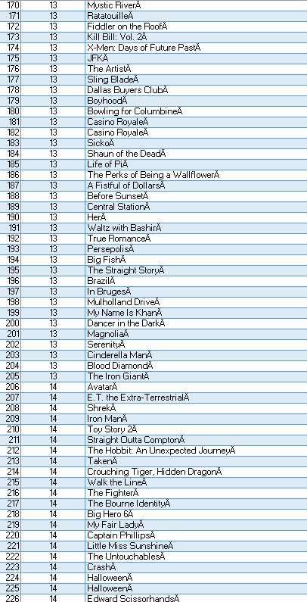
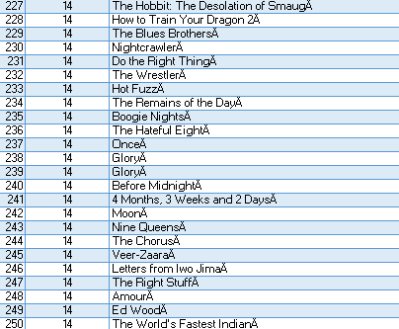
C. Top 250 Movies (acc. To imdb_score, for which num_vote_users > 25000)
First Rank in the list for movie “The Shawshank Redemption” with imdb_score=9.3

Slide 9
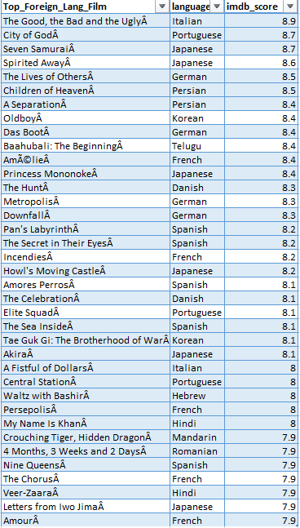
C.Top Foreign Language movies
There are 37 foreign language films in the list.
Top first foreign language film is “The Good, the Bad and the Ugly”, an Italian movie with imdb_score of 8.9.

Slide 10
D. Best Directors
Alphabetically sorted director_name column.
Created pivot table with columns director_name, average of imdb_score.
Sorted average of imdb_score column from “largest to smallest” to get directors with top mean imdb_score.
Created new column topdirectors and displayed with mean imdb_score.
As we did alphabet sorting first, the directors name with tie mean imdb_score are in alphabetic order.

Slide 11
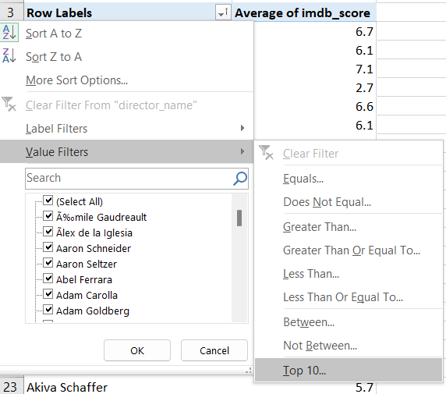
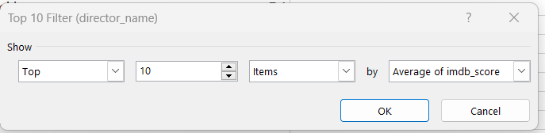
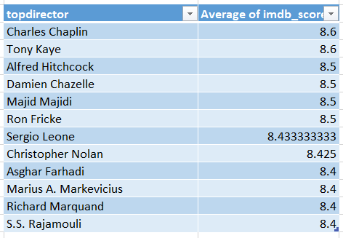
D. Best Directors
The best directors in the list are Charles Chaplin and
Tony Kaye with mean imdb_score 8.6.
We got not 10, but 12 top directors as there are four
directors with 8.5 score and four directors with 8.4 score.

Slide 12
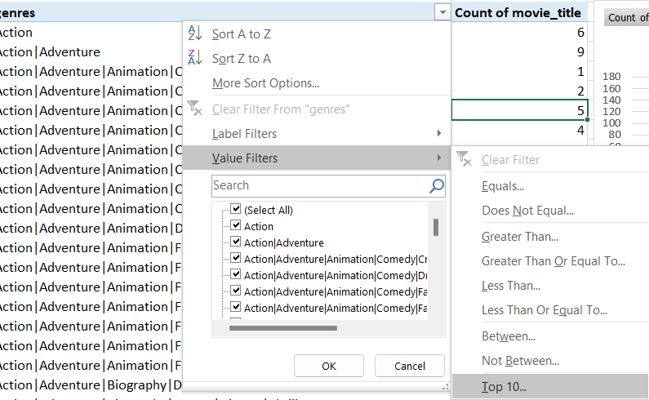
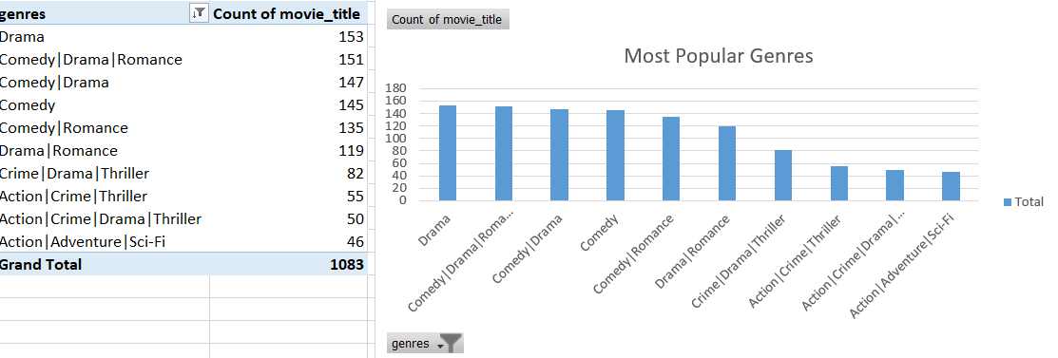
E. Popular Genres
Create Pivot table with genres column with count of
Movie_titles.
Done value filters -> Top 10 items by count of movie_titles
to get top/most popular genres.
Sorted descending by count of movie_titles.
Created a graph with most popular genres.
The most popular genre is Drama with
153 movies count and then
Comedy|Drama|Romance with 151.

Slide 13
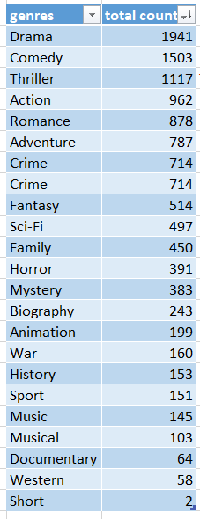
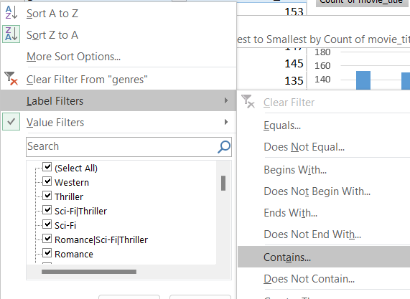
E. Genres as separate counts
I also created a table with each genres separate and movie counts. Using Label filters.
Label Filters -> Contains “genre name” -> ok
Then enter the sum of counts in total count column.
Here we can see that Drama genre
Is on top. So it is the most popular
genre. Next comes, comedy and then
thriller.

Slide 14
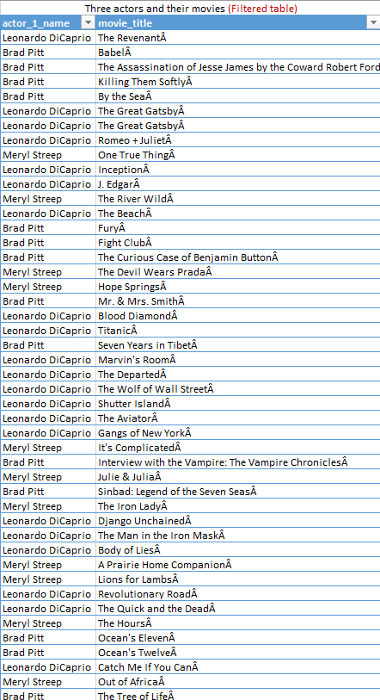
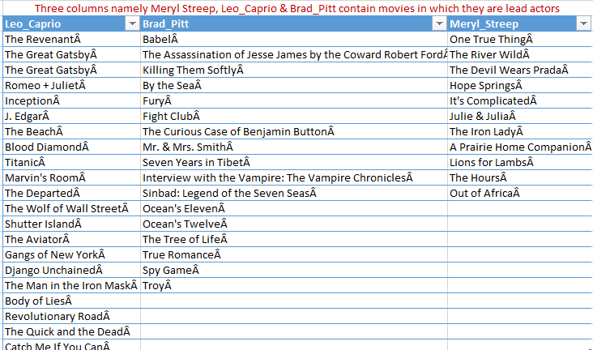
F. Three new columns
First task is to create three columns Meryl_Streep, Leo_Caprio and Brad_Pitt. Extracted the movies acted by them from actor_1_name column with movie_title by using Filter.

Slide 15
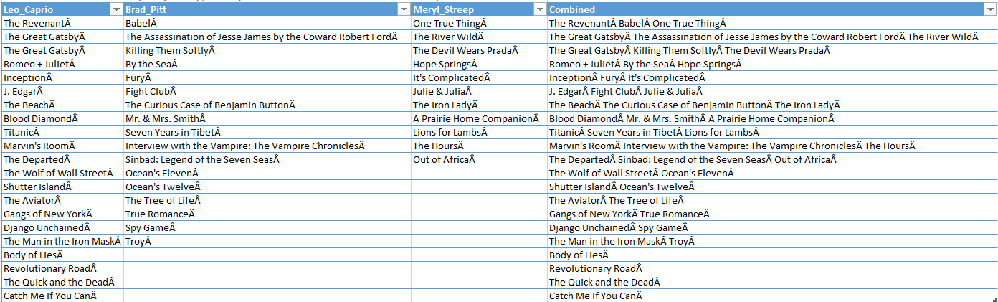
F. Combined column
Next task is to append the rows of these columns and create a new column “Combined”.
Used CONCATENATE() function to join texts from all row.
Result:

Slide 16
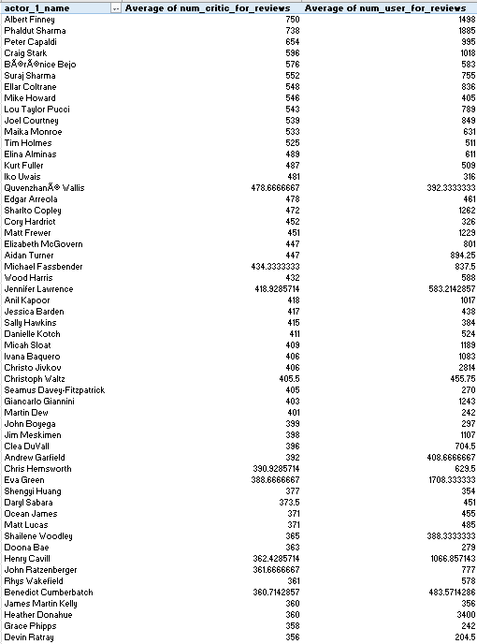
F. Mean
Next task is to find mean of num_critic_for_reviews and
num_user_for_reviews.
num_user_for_reviews is given as text in the column, so
converted them to numbers using: Data -> Text to column.
Copied only required columns to a sheet and then created
pivot table using actor_1_name, num_critic_for_reviews and
num_user_for_reviews.
Then sorted the table descending by Average of
num_critic_for_reviews.

Slide 17
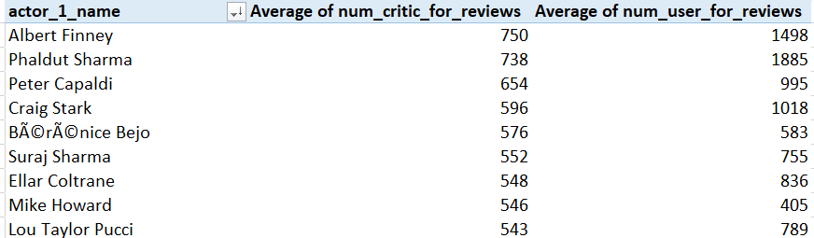
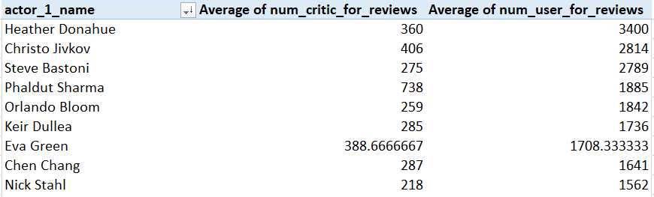
F. Critic favourite and Audience Favourite
From the table,
Albert Finney is the actor who have highest mean of num_
critic_for_reviews. So critic favourite actor is Albert Finney.
And while sorting descending by Average of num_user_for_reviews,
Heather Donahue have highest mean of user review. So,
Heather Donahue is the audience favourite actor.

Slide 18
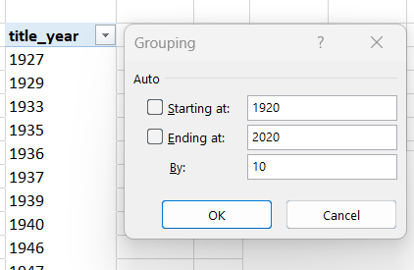
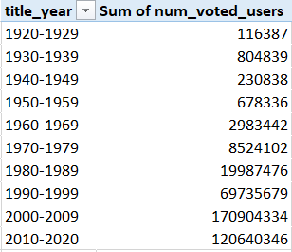
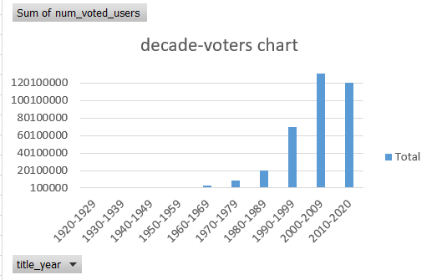
F. Number of voted users over decades
First copied title_year and num_voted_users columns.
Created pivot table. In pivot tools -> Analyze -> Group -> Group selection
Gave values starting at 1920 and ending at 2020 By 10.
This gives us years in groups of 10 ie. Decades.
When sum of num_voted_users is checked we can see that each
decade mostly it’s increasing.
Saved this in a new worksheet
df_by_decade.

Slide 19
Working file
EXCEL 2016 FILE LINK:
LOOM VIDEO LINK: loom_video
https://www.loom.com/share/0e1234b9aa624a149a7586412d0bbd4d?sid=c1c2132c-6e86-4013-b165-bc43d279aee5

Slide 20
RESULT
By doing the IMDB Movie Analysis project I have learned a lot about advanced excel functions, formulas.
Understanding of statistical and logical analysis helped me to do easy calculations and thus to correct answers to the questions.
Most of the analysis included pivot tables and charts, thus got deep into options and pivot tools used for analysis. Learned Charts and visualisation techniques etc.
This project also made me realise analysis can be done in so many ways, that we will reach the final answer through different logic applied.

Slide 21
THANK YOU

